Slide 1
"To analyze a shared world in a sedimented resource And a community in a lonely I, Hold infinity in the trace of a social force, And eternity in the wink of an eye."
Gerry Stahl (channeling William Blake)

Slide 2
Open Foundational Questions in CSCL
How are interactional resources sedimented and how do they integrate a shared world, bridging across individual, group & community levels?
How do individuals emerge from groups & communities and how do they contribute to them?
How can we trace the emergence of social practices out of group interactions?
How can we rigorously conduct thick descriptions (like the wink of an eye)?

Slide 3
The Uniqueness of CSCL
CSCL is a human science, requiring human interpretation to analyze many central issues.
“CSCL is a field of study centrally concerned with meaning and the practices of meaning-making in the context of joint activity, and the ways in which these practices are mediated through designed artifacts.” – Tim Koschmann at CSCL 2002 keynote

Slide 4
Paradigmatic Research
Thomas Kuhn in “The Structure of Scientific Revolutions” (1962) distinguished research within a paradigm from research that defines a new paradigm – tension in CSCL!
Much research in CSCL adopts methods from education, psychology, information science, computer science – which is based on their paradigms
This can produce incremental gains in knowledge within established paradigms

Slide 5
Quantitative Research
The established sciences have benefited from quantitative methods in the past 100 years
Many CSCL researchers were trained in these traditions
However, these methods are based on specific theoretical paradigms – such as cognitive-science theories of cognition and folk theories of cognition
For instance, research based on self-reports or coding rely on the folk theories of subjects or coders

Slide 6
Exploratory Research
CSCL needs new paradigms of cognition, centered on collaborative learning (small groups) and computer support (artifact-mediated)
This requires explorative research, not based on paradigms (and their methods) of other sciences
CSCL research needs to analyze how “practices of meaning making” take place at the group unit of analysis – and how this integrates individual contributions and socio-cultural forces

Slide 7
Two Exploratory Agendas
Theory: "To analyze a shared world in a sedimented resource”: how to integrate individual, small group & community units of analysis with interactional resources
ijCSCL issues 2012 (4), 2013 (1), 2013 (2)
Workshop on “Levels of Learning” at CSCL 2013
Design-Based Research: The Virtual Math Teams (VMT) Project 2002-2015
Stahl (2006, 2009, 2013)

Slide 8
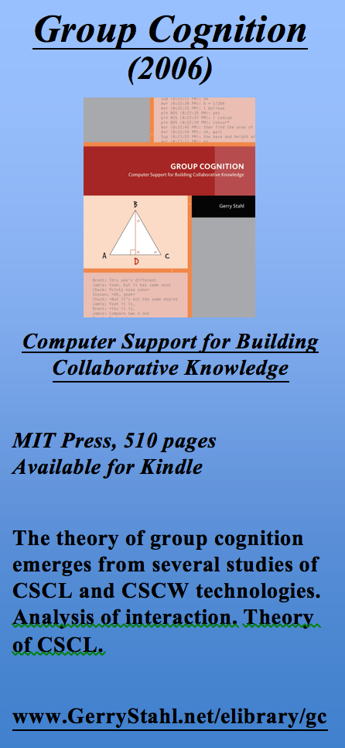
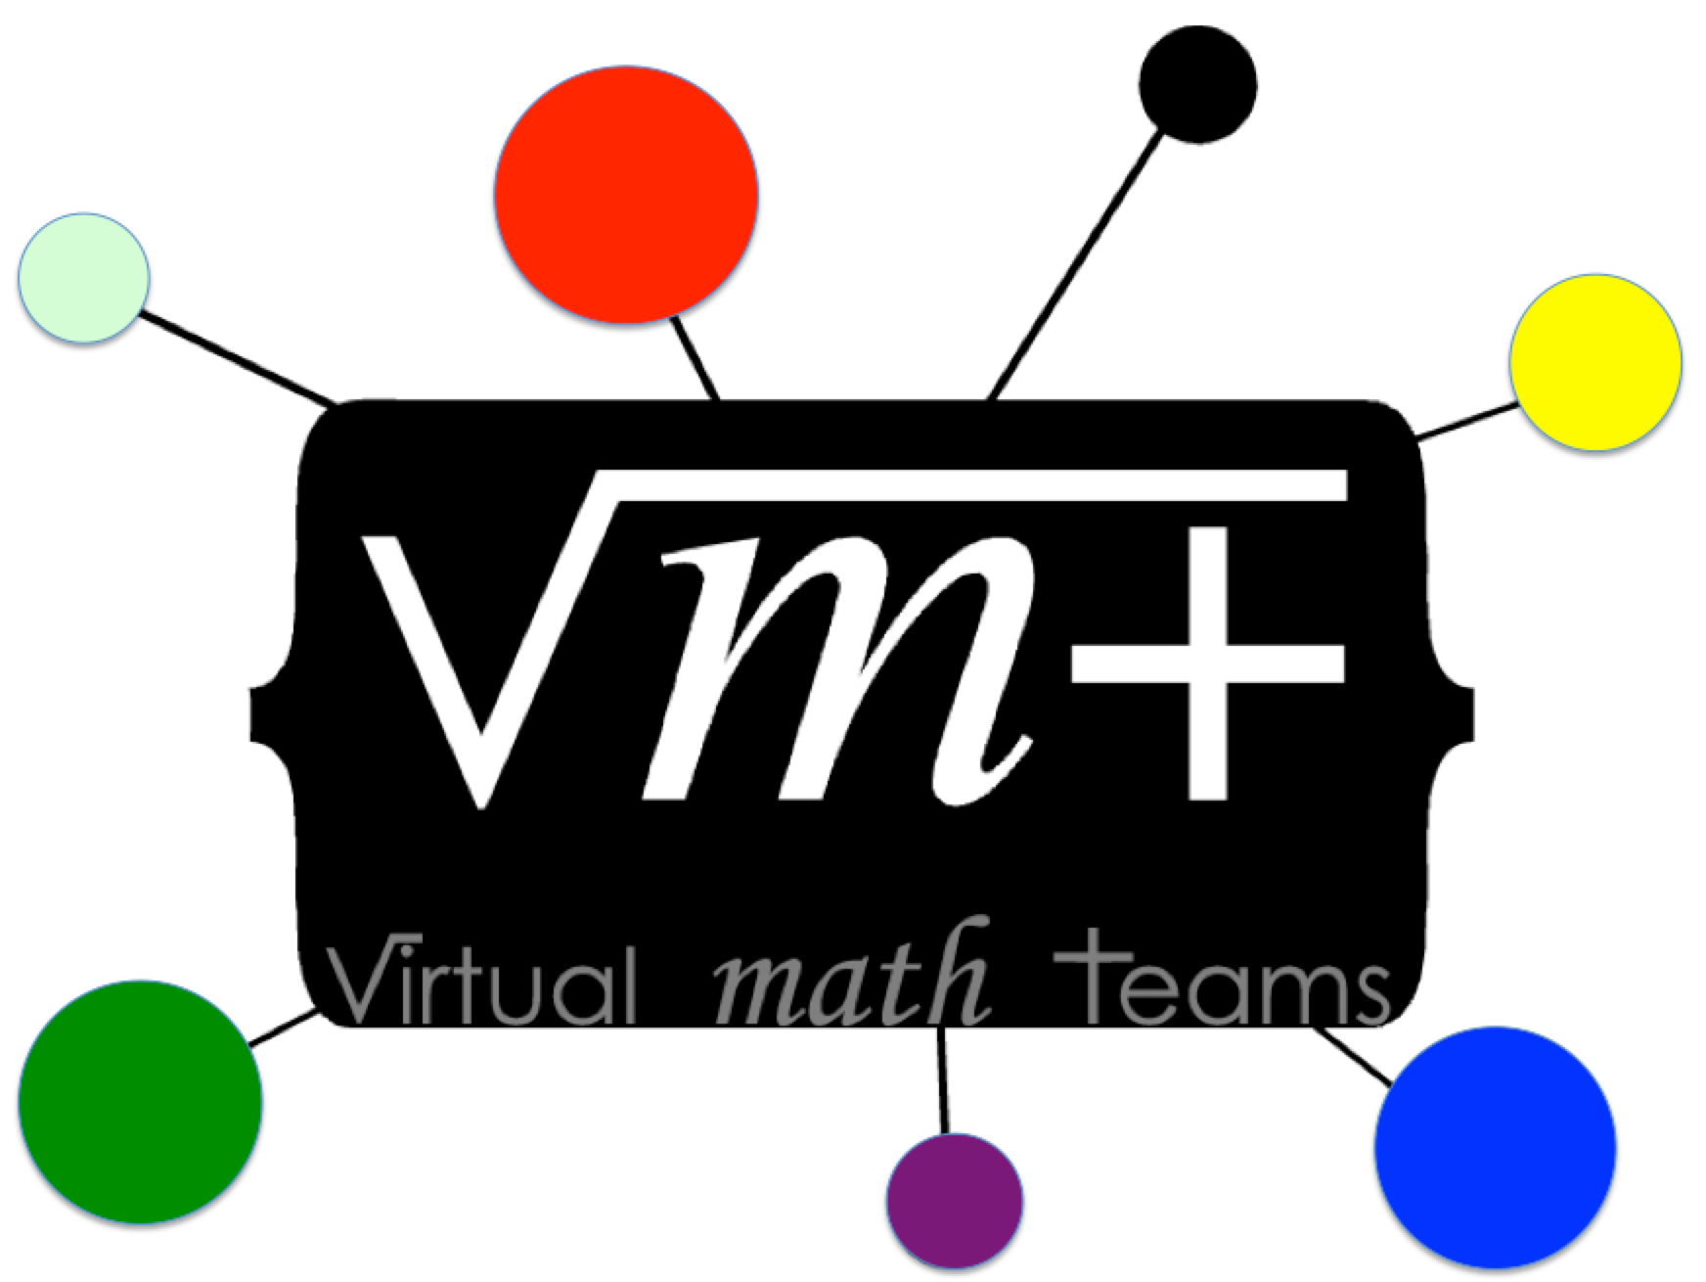
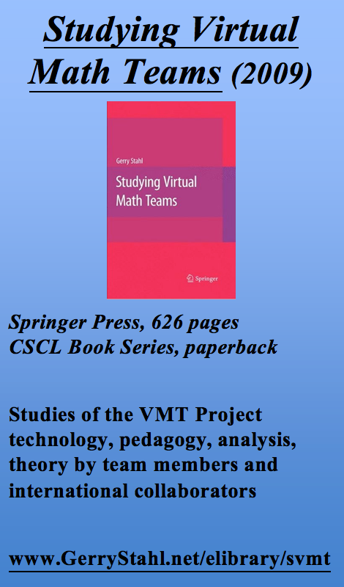
The Virtual Math Teams Trilogy

