Slide 1
Resources for Connecting Levels of Learning
Gerry Stahl
Diler Öner

Slide 2
Small-Group
Interactional resources
Group Outcomes
Group
Knowledge
Artifacts
Interaction
Context
Sequential
Small-Group
Interaction
Technology & Media
Community
Individual
Voices
Culture of
Discourse
Community
Individuals’
Resources &
Experiences
Individual
Levels of analysis connected by interactional resources

Slide 3
In a series of sessions, a particular math topic connects group work to traditional mathematical content and elicits individual contributions; it guides & structures both small-group interaction and the group’s trajectory of work
Interactional resource = problem of inscribed triangles
Individual level = 2, 3 or 4 participants
Small-group level = dyad or triad or quad
Community level = school math practices and geometry content – introduced in the classroom by the teacher and in the culture by enculturation

Slide 4
Öner (2013) contrasted social/collaborative/relational resources with content-related resources:
Text chat versus shared-whiteboard graphics: Çakir, Zemel & Stahl, 2009
Building a joint problem space (JPS) versus solving a problem: Roschelle & Teasley, 1995
A relational space versus a content space: Barron, 2000
Diachronic content versus temporal dimensions of the JPS: Sarmiento & Stahl, 2008
Project discourse versus mathematical discourse: Evans et al., 2011
Spatio-graphical observation (SG) versus technical reflection (T): Laborde, 2004

Slide 5
Öner’s (2013) analysis focuses on small-group processes (discourse, relationships, observation, shared attention) vs. math practices (defining problem, solution steps, solution path)
Stahl (2013) construes the math problem as an integrating resource:
dragging to discover vs. constructing to create dependencies

Slide 6
In 4 experiments with a variety of groups, all successful groups use dragging to explore for constraints, exploratory construction to search for solution, design of dependencies;
The inscribed-triangles problem is a resource that guides the group processes of meaning making and those of math solving

Slide 7
Öner (2013) : F2F with Geometer’s Sketchpad and grad students

Slide 8
VMT with GeoGebra with researchers

Slide 9
VMT with math teachers

Slide 10
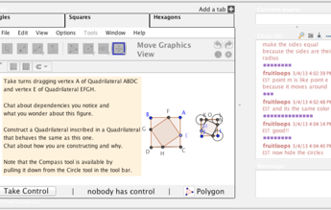
VMT triangles and squares with middle school students

Slide 11
VMT Topic with triangles, squares, hexagon polygon generalization

Slide 12
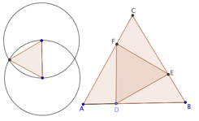
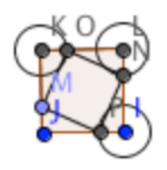
Community: Euclid’s 1st proposition (construct equilateral triangle), problem of inscribed triangles, definitions of regular polygons.
Individual: perception of equal lengths, coordinated movements, explorative dragging, memory of similar problem solutions
Small group: group practices of taking turns, dragging, coloring, naming, discussing
Group cognition: shared attention, collaborative discourse, joint solution

Slide 13
Further Reading
Öner, D. (2013). Analyzing group coordination when solving geometry problems with dynamic geometry software. ijCSCL. 8(1).
Stahl, G. (2012). Traversing planes of learning. ijCSCL. 7(4).
Stahl, G. (2013). Learning across levels. ijCSCL. 8(1).
Stahl, G. (2013). Transactive discourse in CSCL. ijCSCL. 8(2).
Stahl, G. (2013). Translating Euclid: Creating a human-centered mathematics: Morgan & Claypool Publishers. Web: http://gerrystahl.net/elibrary/euclid.

Slide 14
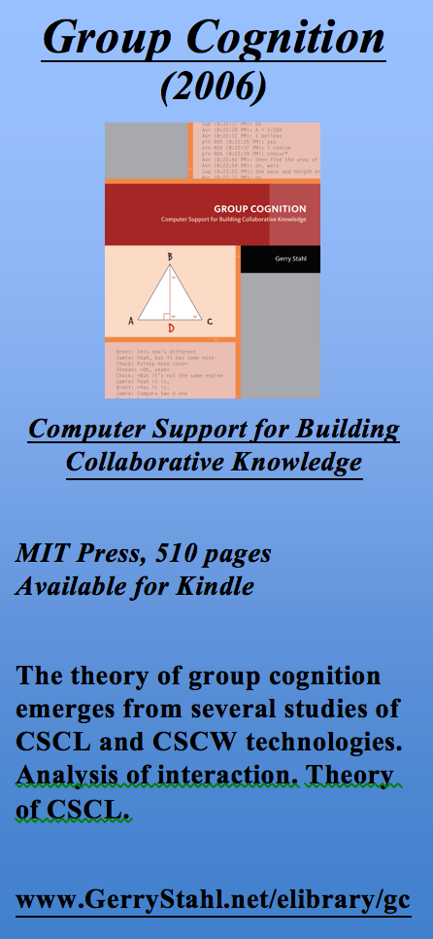
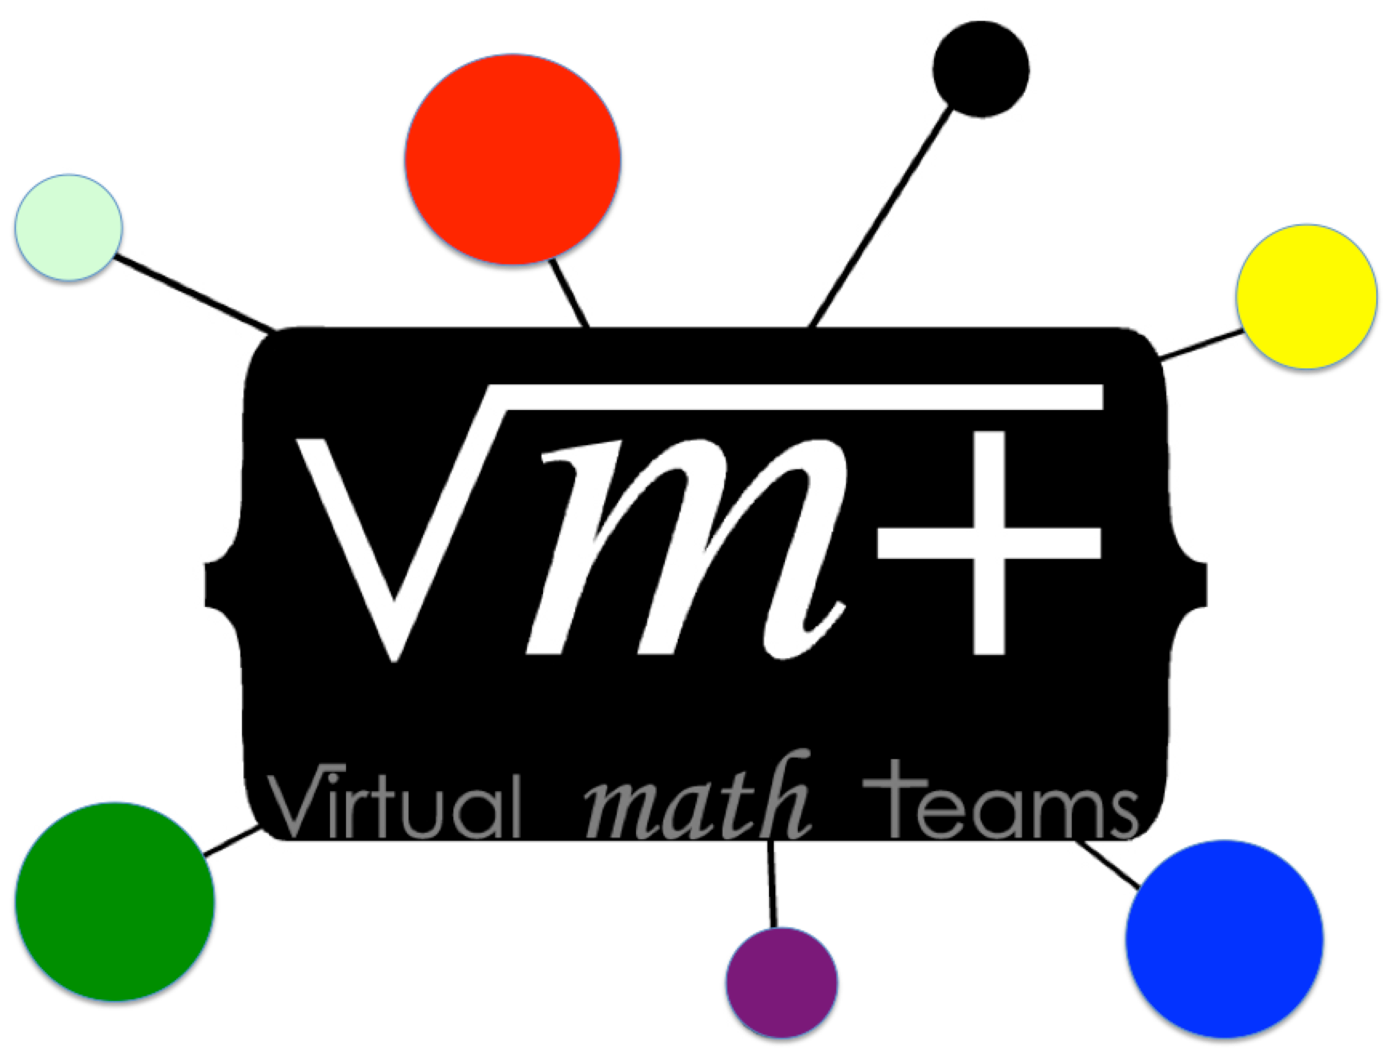
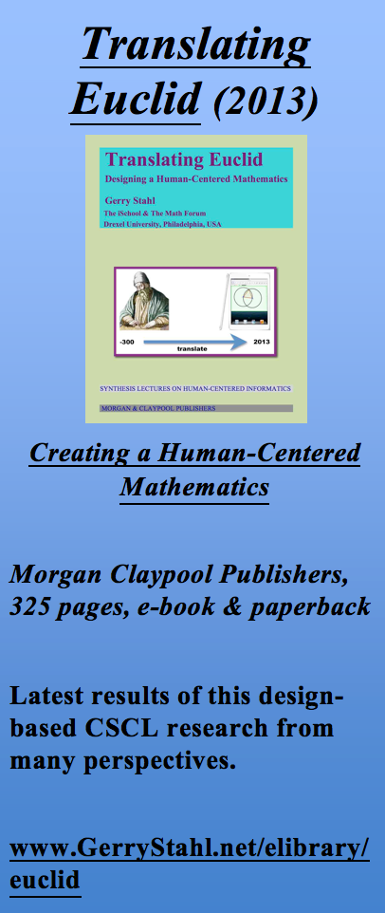
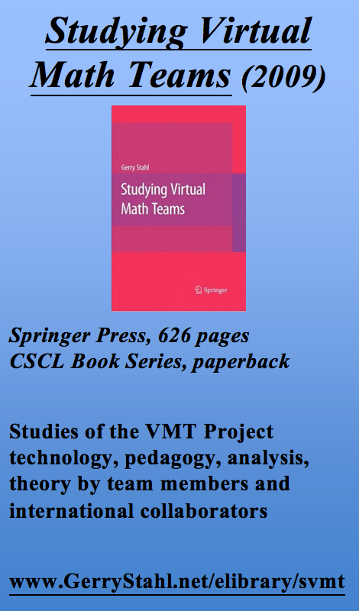
The Virtual Math Teams Trilogy

