Slide 1
Damsa’s Model as a knowledge object
University of Oslo, Norway
October 18, 2013
Gerry Stahl

Slide 2
Damsa’s Model as a Knowledge Object
State of the art theoretical framework
Visualizing the coherent theoretical model
The dissertation as a knowledge object
Contributions to my personal perspective
Integrating the model with VMT
Knowledge challenges now

Slide 3
1. State of the art theoretical framework
Knowledge Co-construction
Social Interaction
Joint Elaboration of Knowledge Objects
For the field of CSCL (computer-supported collaborative learning), these are key current concepts in need of clarification & research.
Many of the leading-edge theories have been brought together, presented and extended in this dissertation.

Slide 4
The dissertation surveys in a finely tuned and strategically selective way leading-edge conceptualizations from the literatures of sociolinguistics and sociocultural CSCL.
In a field awash in vague theories from diverse and incommensurate historical sources, the dissertation has managed to assemble some of the most relevant, compatible and sophisticated conceptualizations. It has identified key principles and organized them around four relatively clear and distinct, though intimately inter-related concepts. It has then tested this model by applying it in four studies, each of which has stood up to peer review within the field. The four studies provide clear views of the four concepts, respectively. They also illustrate impressively the connections among the phenomena named by the concepts. This dissertation not only stands at the leading edge of theoretical, analytic and practical work in the field, but also pushes that edge forward.

Slide 5
Should she be awarded a PhD?
Did she master a specific area of the discipline?
Did she demonstrate ability to conduct research?
Can she articulate ideas and teach them to others?
Has she opened a research agenda to pursue?
Has she demonstrated appropriate maturity as a researcher in the field?

Slide 6
A doctoral education is primarily an apprenticeship in research. Gradually, the apprentice demonstrates the capacity to move into a more leadership position in the community.
The assessment of relevant claims and issues are a matter for judgment by experts in the field – both the local mentors and less involved people from outside.
We are all here today because that assessment has now been made in favor of recognizing the apprentice’s impressive accomplishments.

Slide 7
2. Visualizing the coherent theoretical model
Productive Interactions
Shared Epistemic Agency
Shared Knowledge Objects
Interaction Trajectories
How do these fit together to provide a theoretical model of collaborative learning?
Notes:
Throughout my talk, I will focus on these four theoretical constructs that are at the heart of the dissertation.

Slide 8
Productive Interactions
Shared Epistemic Agency
Shared Knowledge Objects
Interaction Trajectories
A group (has the capacity to) develop a knowledge object. This takes place via productive interactions, which follow a trajectory over time.

Slide 9
This has the structure of a simple subject-object relationship between a mind and the world:
Vygotsky introduced the artifact, which mediated consciousness:
Engeström added the socio-cultural dimension from Marx (community, rules, division of labor):
But this still lacks the individual-group connection of agency & interaction, and the temporal dimension of trajectory, as well as the multiple roles of the knowledge object as starting point, resource, mediating artifact, evolving product.
Subject
Object
Artifact
Subject
Object
Artifact
Subject
Object
Rules
Com-munity
Division of Labor

Slide 10
Notes:
Here is a model I started to sketch in 2000. It captures some of the elements of Damsa’s theory.

Slide 11
IT
KO
KO
PI
SEA
KO

Slide 12
Connecting levels of analysis with resources
KO
Small-Group
KO
Group Outcomes
Task
Group
Knowledge
Artifacts
PI
IT
Interaction
Context
KO
Sequential
Small-Group
Interaction
SEA
Technology & Media
Community
KO
Individuals’
Resources &
Experiences
Individual
Voices
Culture of
Discourse
Community
Individual
The sequential small-group interaction brings in resources from the individual, small-group and community planes and involves them in shared meaning-making. This requires co-attention to the resources and thereby shares them. The process results in generating new or modified resources, which are then retained at the various planes. The resources often take the form of designed physical artifacts and sedimented (frozen) language.
Notes:
Here is another graphical representation, which tries to illustrate the connections between different units of analysis, as mediated by productive interaction.

Slide 13
Refining theory through interaction analysis
What is going on in the following interaction?
Can we see productive interaction?
  Can we see shared epistemic agency?
  Can we see co-construction of a shared knowledge object?
  Can we see an interaction trajectory?
  Does this data give us new insight into any of theses theoretical concepts?

Slide 14
Excerpt 3. Group D’s discussion (5th project week)
1. Alice: “… Shall we try to organize our ideas about feedback, what we talked about before… some terms and definitions we need to understand so we know what we want to investigate… let’s get the questions.
2. Elly: …oh, yes, the project plan, let’s get that document with the questions we already formulated.
3. Elly: What do we call feedback?
4. Jane: Let’s first see…, what is feedback for us, and what is feedback in the VLC.
5. Alice: Shall we just look what we wrote about that in the plan? […]
6. Jane: So, we can indicate here that feedback can be given in different ways and that we focus on peer-feedback, suggestions for improvement and rating from peers.
7. Elly: Yes, then we can elaborate. Let’s write that down. (Typing)
8. Elly: Ok, what is feedback?
9. Alice: Feedback is… how is it defined in those sources?
10. Elly: I don’t have them, but I remember… linking back the results of the collaboration.
11. Jane: We must first write the definition of feedback.
12. Elly: But don’t forget we focus on peer-feedback. 4-re-framing focus
13. Alice: But linking back the results of collaboration is too vague…
14. Jane: The reaction, … or response than…?
15: Alice: Yes, response, it is response on a…, you could say, product, from a peer?
16. Elly: … inside de VLC…
17. Jane: Yes, don’t make it too complicated. Suggestions for improvement for the product in VLC by peers. 18. Alice: OK. (Typing) …”

Slide 15
3. The dissertation as a knowledge object
Productive interaction: Crina’s interactions at Oslo, K-P Lab, Netherlands, Rutgers, etc.
Shared epistemic agency: Part of the research effort, esp. Nordic socio-cultural
Interaction trajectory: Design-based research iterations, paper/dissertation drafts, schooling
Shared knowledge objects: The dissertation – including the 4 papers and earlier drafts.

Slide 16
A. Productive interaction
“The point of departure for this dissertation was that we learn and we build our knowledge together with others. It is a social process in which people, ideas, resources, and context all play a role. I believe the work that went into this dissertation is a very good illustration of this assertion. It builds upon a great collection of scientific ideas, resources and traditions, and it is the result of inspiring and enriching interactions with diverse individuals and communities.” (Acknowledgements)
Notes:
What better way to start discussing the dissertation as a socially co-constructed shared knowledge object than to quote the very first words of the dissertation document itself?

Slide 17
A. Productive interaction
The author’s efforts and interactions were aimed at producing a knowledge object that would become part of the CSCL research literature.
Early drafts and papers served as resources for continuing productive interactions.

Slide 18
B. Shared epistemic agency
The Department of Education at Oslo is structured to guide and support doctoral students to produce dissertation knowledge objects.
The author was trained in conducting research leading to publishable objects.
Groups she interacted with were also structured and experienced in co-constructing knowledge objects.

Slide 19
C. Interaction trajectory
The research trajectory is often hidden in research presentation objects.
However, this one explicitly discusses the design-based research trajectory of its research involving the 4 experiments.
Much of the evolution of knowledge is necessarily hidden when the current state of knowledge is frozen in an object.

Slide 20
D. Shared knowledge objects
The dissertation and 4 papers, shared with the research community
What are the preconditions (agency) for the community to understand this knowledge?
Understanding of the cited (Nordic socio-cultural and socio-linguistic) leading-edge literature
Follow the dissertation argument and details of the papers
Able to use it in co-constructing one’s own knowledge objects

Slide 21
A problem with the dissertation form as based on four publications. While it is trendy to base a dissertation on publications and it adds a level of peer review, it also distorts the presentation of the dissertation as a coherent, evolving knowledge object. The four publications are somehow fixed, having been written at different times and no longer open to adaptation to growing ideas. The papers were originally conceived as specific segments of the dissertation, but the publications may have been pushed in different directions by peer reviews, while the dissertation project moved in another way. In addition, the four presentations are necessarily highly redundant with material in each other and in the non-published parts of the dissertation. Textual knowledge objects have specific forms and it is not necessarily true that the form of a good journal article is also the form of a good dissertation section.

Slide 22
4. Contributions to my personal perspective
Productive interaction: discourse that contributes to co-constructing knowledge object
Shared epistemic agency: the capacity of a small group to engage in co-constructing knowledge objects
Interaction trajectory: Developing agency, defining task, constituting group, understanding task, bringing in resources, problem solving, recognizing end, summarizing
Shared knowledge objects: starting task situation, resources, mediators (tools, media, mentors, language), evolving knowledge product
Notes:
I have tried to understand the central contributions of the dissertation in my own language. I hope I have not distorted or trivialized this work. Obviously, there are many aspects I have not addressed, such as methodology, pedagogy and the experimental results.

Slide 23
5. Integrating the model with VMT
Productive interaction: focus on interaction excerpts that co-construct knowledge objects
Shared epistemic agency: focus on supporting group’s collaboration capacity
Interaction trajectory: focus on changes over time in capacity and construction … and how the group enacts those changes
Shared knowledge objects: focus on many roles of knowledge objects in the process

Slide 24
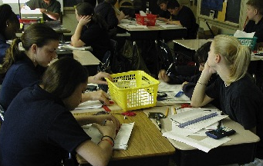
A. Productive interaction

Slide 25
B. Shared epistemic agency
before and after

Slide 26
C. Interaction trajectory

Slide 27
D. Shared knowledge objects
KO
KO
KO

Slide 28
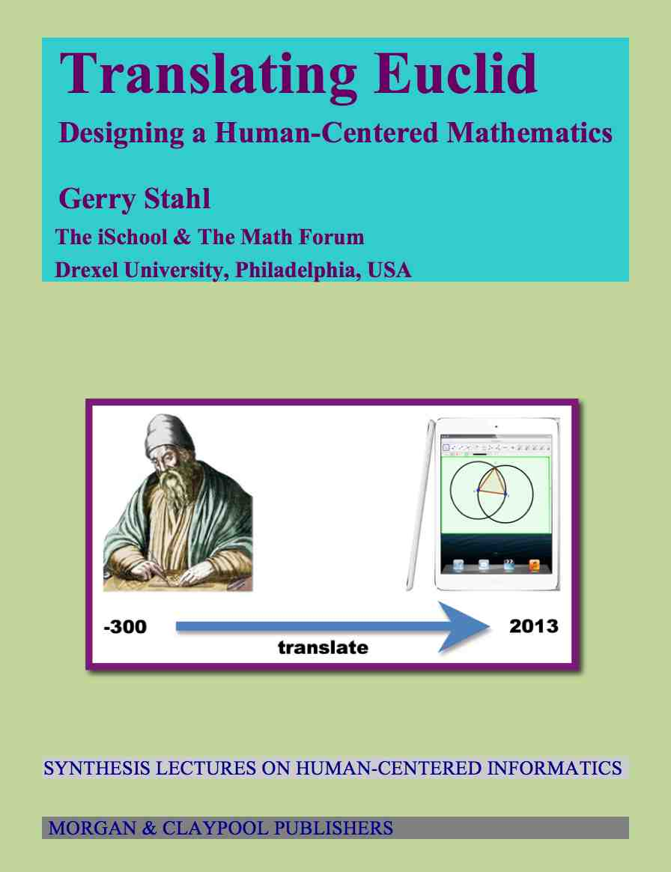
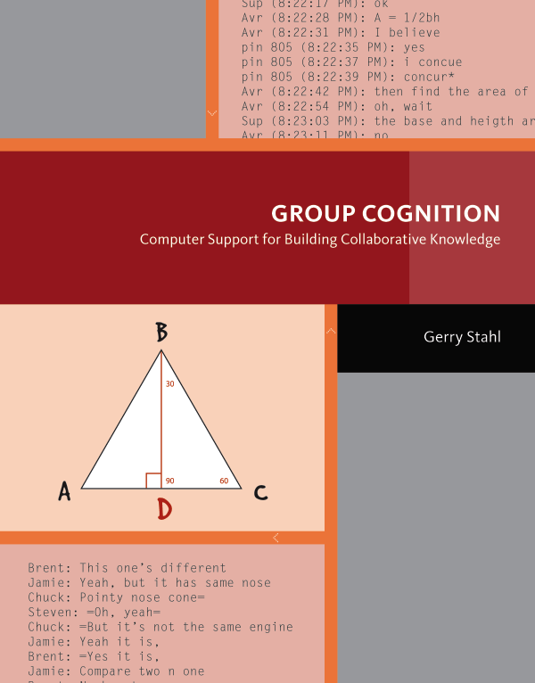

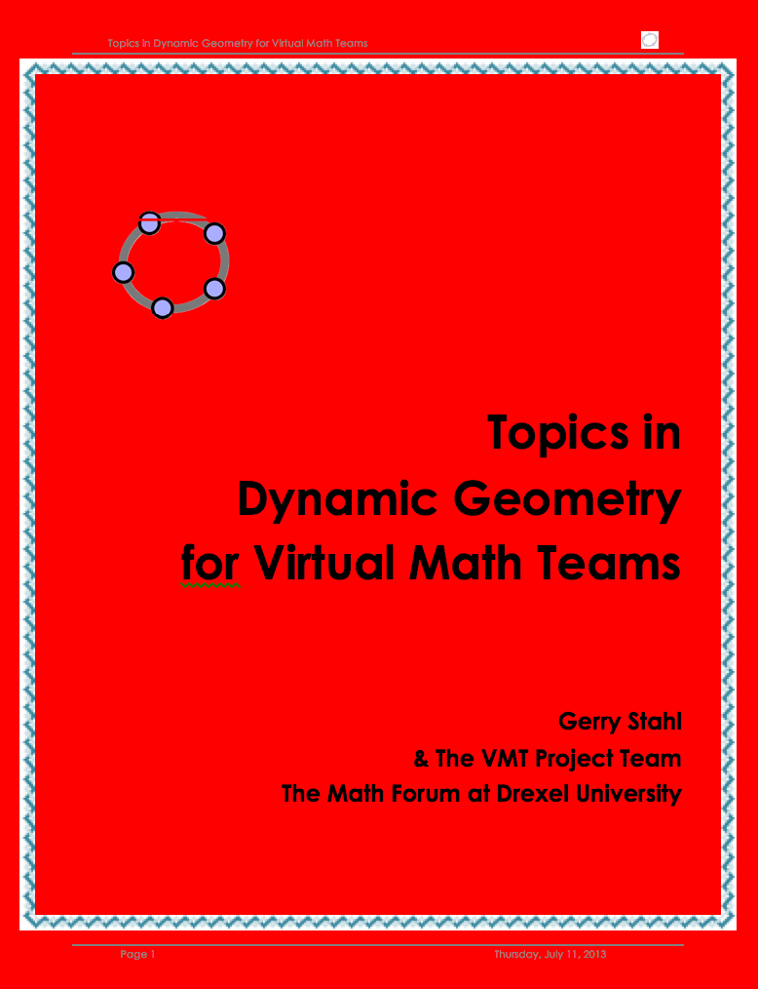
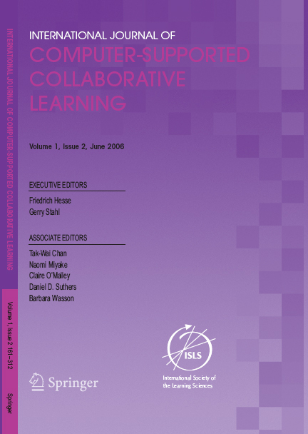
D. Shared knowledge objects

Slide 29
E. Methodology & Pedagogy
Design-based research – because inquiry is iterative and you do not even know the question at first
Cases & excerpts – because each case is unique and you need to understand it in some detail
Interaction analysis – because discourse is essentially sequential and coding/stats throws out the important
Group unit of analysis – because co-construction is there; capture all the group interaction
Small group & no one else – because peers understand each other best, they need to build on each other semantically, the object has to be shared – let them struggle; no division of knowledge work

Slide 30
6. Knowledge challenges now
Productive interaction:
How does interaction take place through discourse mechanisms and semantic resources?
How do groups become more productive in their discourse?
How does discourse get sedimented or frozen in knowledge objects? How can this be supported or facilitated?

Slide 31
6. Knowledge challenges now
B. Shared epistemic agency:
Can we see the growth of agency in interaction analyses?
How does group agency relate to individual agency?
How can we facilitate and support development of shared epistemic agency?

Slide 32
6. Knowledge challenges now
C. Interaction trajectory:
How can we collect complete data for productive interaction over longer time periods?
Are there typical trajectories of productive interaction?
How do groups construct and understand their trajectories?

Slide 33
6. Knowledge challenges now
D. Shared knowledge objects:
How are these related to artifacts (Activity Theory), tools (Heidegger), instruments (Rabardel), inscriptions (Latour), resources (Stahl), etc.?
In what ways and senses are they “shared”?
What are the different roles they can play in productive interaction and how are these roles connected?

Slide 34
The future for Crina Damsa
Celebrate!
End of doctoral studies
On-going research agenda
Increased activity in research community
Notes:
Congratulations on a job well done!

Slide 35
For further info…
Email:
  Gerry@GerryStahl.net
Website:
www.GerryStahl.net
Translating Euclid:
  www.GerryStahl.net/elibrary/euclid
These slides
www.GerryStahl.net/pub/damsa_opponent.pdf

