Slide 1
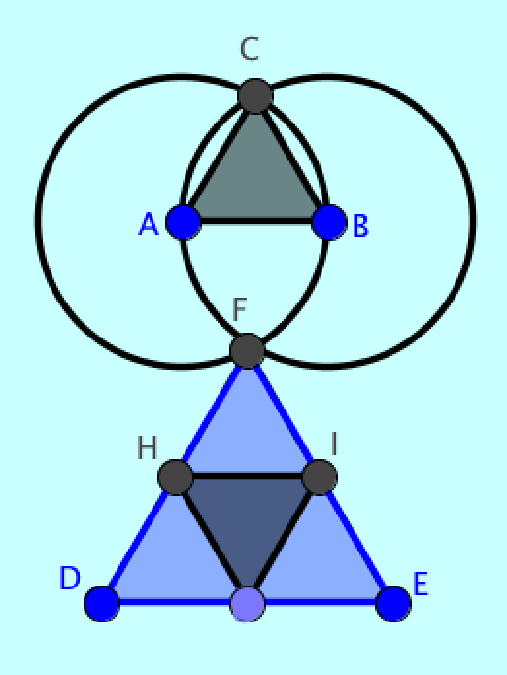
Designing a learning environment for geometry
LinCS Seminar, Göteborg
October 9, 2013
Gerry Stahl
Notes:
Today I would like to present the approach to design that I wrote about in my new book on my research in the VMT Project.
The Virtual Math Teams Project is an effort to support collaborative learning of mathematics.

Slide 2
Dimensions of Design
Viewing the whole design agenda
Translating the history of geometry
Understanding the philosophy of geometry knowledge
Mastering the mathematics
Building the technology
Supporting collaboration
Researching the learning processes
Theorizing the approach & resources
Defining the pedagogy
Developing the curricular resources
Design-based research of human-centered geometry
Notes:
The design effort for educational technology involves many dimensions of consideration.
These are the 11 chapters of my book, “Translating Euclid”
They are also the 11 parts of my presentation today.

Slide 3
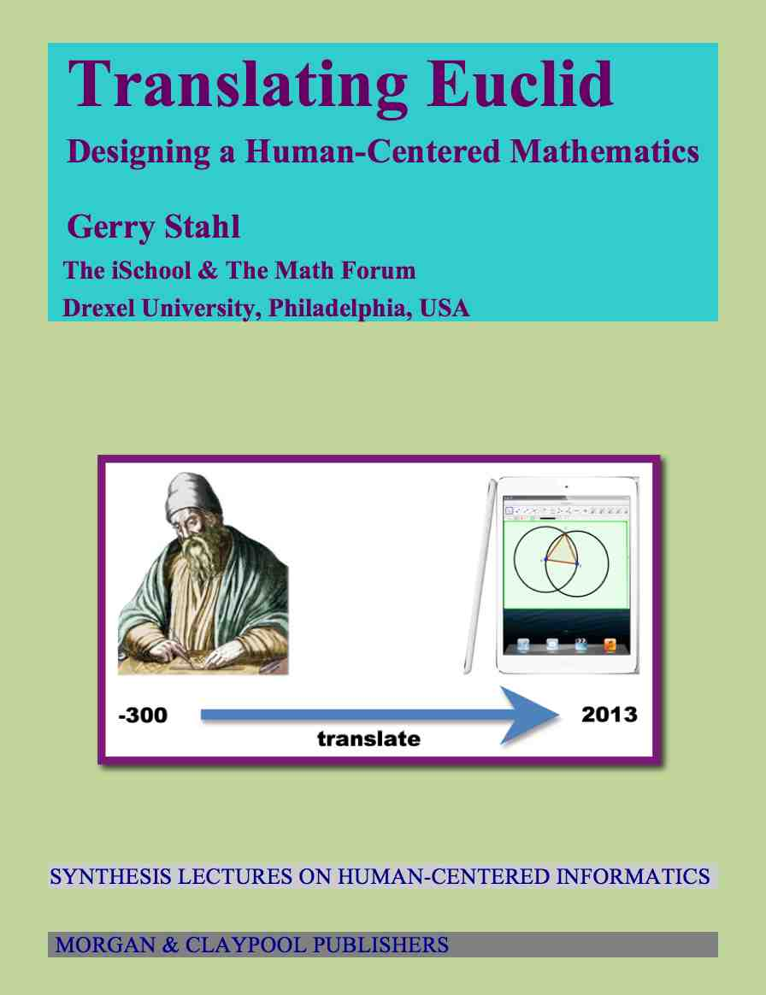
1. Viewing the whole design agenda
How should one translate the classic-education approach of Euclid’s geometry into the contemporary vernacular of social networking, computer visualization, and discourse-centered pedagogy?
A multi-dimensional, iteratively evolving design-based research approach to designing a human-centered, 21st century geometry education using computer-supported collaborative learning
11 chapters of Translating Euclid book
Notes:
This is how I formulate my Research Question.

Slide 4
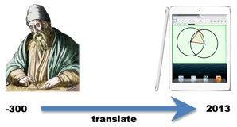
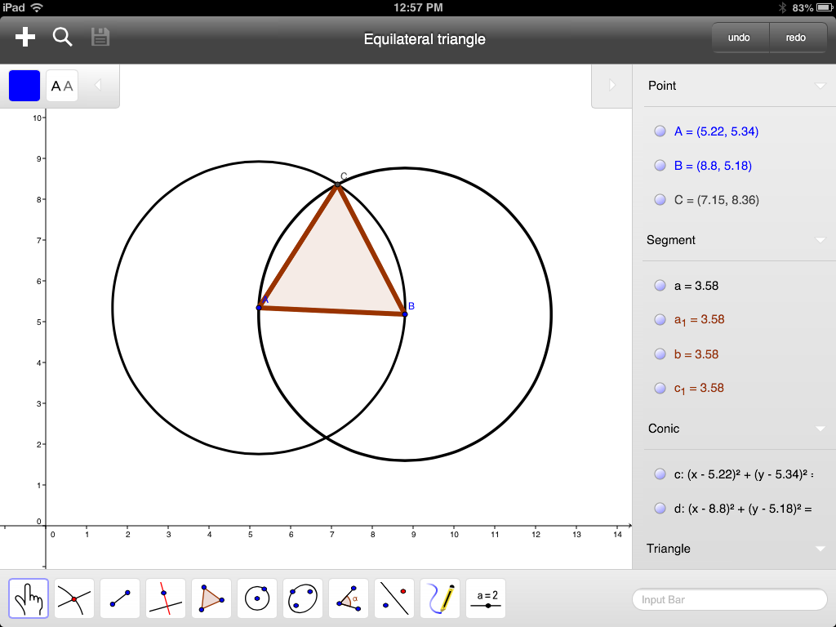
Translating from clay tablets to iPad tablets
Notes:
I want to discuss the movement from the ancient roots of geometry to its future potential.
When I created this graphic six months ago, I had to photoshop the image of GeoGebra on an iPad.
For today’s talk, I was able to capture an image of GeoGebra on my iPad.
That is how fast this field is changing!

Slide 5
2. Translating the history of geometry
Early Greeks explored using persistent diagrams and specialized text in small, distributed community
Euclid systematized a set of postulates that built on each other to construct and prove properties of figures. Established deductive argumentation
Successive further bureaucratization of proofs as objective truth
Axiomatization and formal logic. Euler extensions. Non-Euclidean geometries
Dynamic geometry using computer interface
Notes:
The nature of geometry and of geometry education has changed dramatically over the centuries.
It is still changing, and we can influence that change with powerful software design.

Slide 6
3. Understanding the philosophy of geometry knowledge
Alienation of geometric objects from human creators – starting with Plato’s world of ideas
Abstraction from the construction process enabled progress, but reified the constructs into other-worldly, mental objects
The social construction of geometry was obscured by a focus on individual thought and knowledge; a widespread ideology of individualism
Notes:
Viewed philosophically, the history of geometry has two sides: the good and the bad.
The good is that it contributed to rational thinking.
The bad is that it led to a philosophy of other-world objects and
An ideology of thought as individualistic

Slide 7
4. Mastering the mathematics
Dynamic geometry offers a potential to retrieve the human-centered nature of geometry as a product of creative-discovery
Collaborative dynamic geometry offers a potential to retrieve the social nature of geometry as a product of community discourse
At the core of dynamic geometry is the concept of dependency. Proof can be understood as a consequence of constructed dependencies, based on a dialectic of discovery and creation
Notes:
Dynamic geometry was created in the 1990s through software design.
It offers a potential.
That potential is still not well understood.

Slide 8
Notes:
Constructing dynamic geometry objects like the points on these two lines
Illustrates the idea that some objects are dependent on others.
Basic principles of traditional geometry can be understood in terms
Of these constraints and dependencies.

Slide 9
5. Building the technology
Geometer’s Sketchpad, Cabri, etc. pioneered the creation of dynamic geometry
GeoGebra makes it freely available and integrated with other math (3-d, algebra, statistics, spreadsheet, trig, calculus, etc.)
VMT provides a collaboration environment and integrates the first multi-user dynamic geometry
The next dozen slides describe the design of the Virtual Math Teams (VMT) online environment
Notes:
To support collaborative learning (CSCL), we had to redesign GeoGebra to be multi-user
For online collaboration

Slide 10
Virtual Math Teams (VMT)
VMT is an online environment for students to work on and discuss math problems synchronously.
VMT combines support for dynamic geometry with media for collaborative learning.
Notes:
VMT has been under development since 2003.

Slide 11
VMT with multiple GeoGebra tabs
Notes:
Now the VMT environment can include multiple GeoGebra tabs
They are integrated with the chat communication channel
And many other features for collaborative learning.

Slide 12
Integration with GeoGebra
Remote students can synchronously work on a shared construction together.
Users can take turns manipulating the construction.
  Adding, deleting, modifying and moving objects
The construction will stay in sync on each user's screen.
Users can chat about the problem as they work.
Notes:
Students can collaborate in real time on a shared construction.

Slide 13
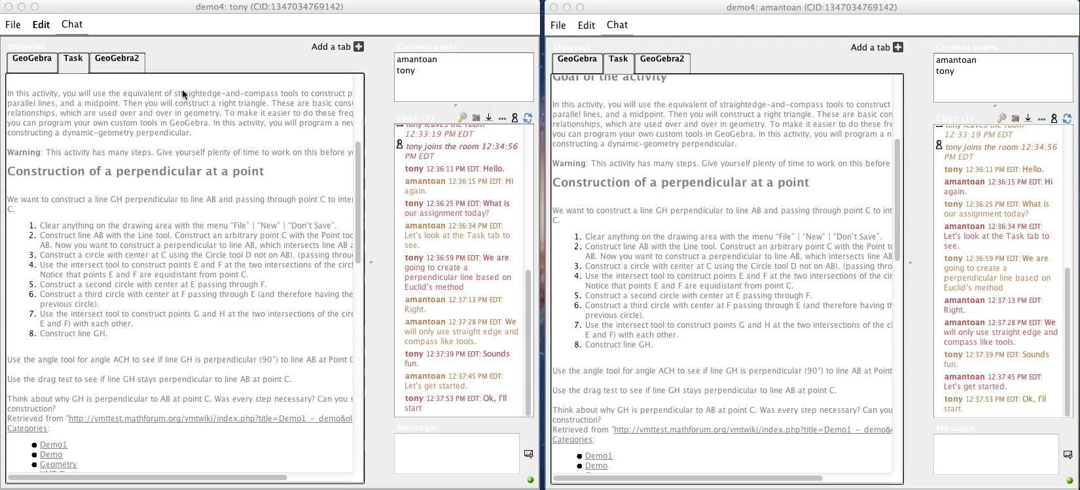
Multi-user GeoGebra
Notes:
Show movie

Slide 14
History Tracker
Built-in history tracker allows users to scroll back and forth in time to see how the construction developed.
Shows everything that happened including style changes and object movements.
Each GeoGebra workspace is tracked separately.

Slide 15
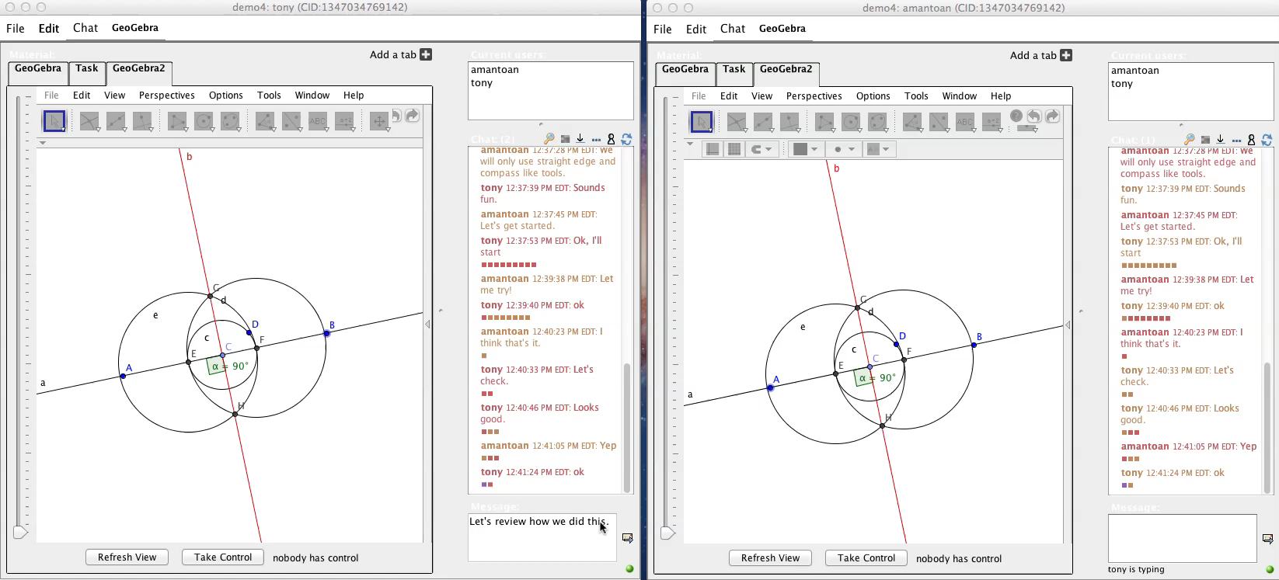
History Tracker In Action
Notes:
Show movie

Slide 16
Other Shared Tools
Shared Whiteboard
  Users can doodle on the shared whiteboard
  Draw simple shapes
  Summarize work, draft shared statements, note observations or hypotheses in text boxes
  History of the whiteboard is also tracked.
Web browser
  Simple web browser
  Can be used to show instructions for the student's assignments or other related information on the web.
Notes:
There are several other kinds of tabs in VMT
To support individual, group and classroom-wide learning

Slide 17
VMT has built in tools for session analysis
VMT records every chat, and action in the session.
Provides a session replayer to go back and forth through the session step by step.
Chat, whiteboard, and GeoGebra events all playback in the order they occurred in the original session.
Notes:
Tools allow review by students, teachers, and researchers
For reflection, evaluation and analysis

Slide 18
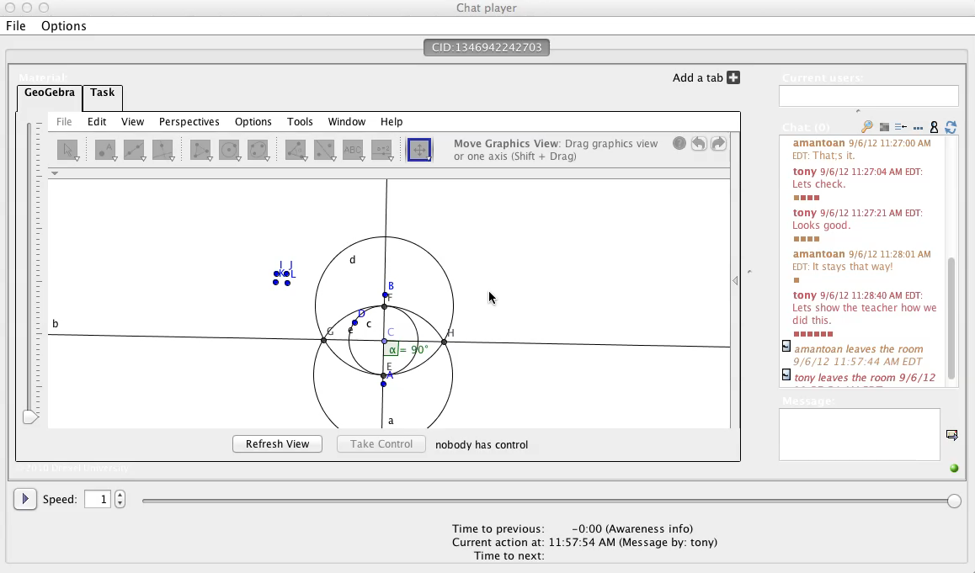
The VMT Session Replayer
Notes:
Play movie

Slide 19
VMT has built in tools for session analysis
Spreadsheet log files can be downloaded for each VMT room – by anyone: students, students from other teams, parents, teachers, researchers.
Log files and the VMT Replayer provide unique insights for teachers and researchers.
Allows teachers to go back and see anything that teams did in the chat rooms.

Slide 20
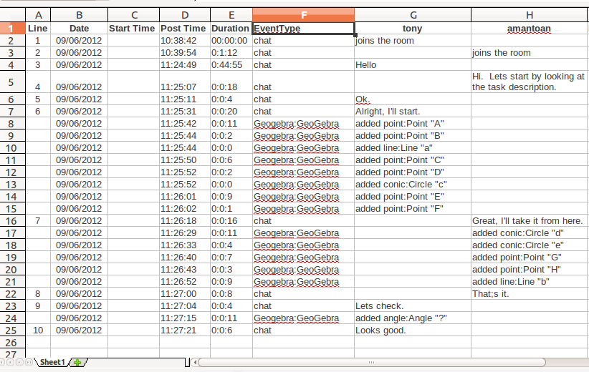
Session Log Files
Notes:
Logs can be displayed with a different column for each student’s chat postings
They can be filtered to display chat positings, GeoGebra events and system messages
Like a student entered or left the chat room or opened a different tab or chose a GeoGebra tool

Slide 21
VMT Is Publicly Available
VMT is open source.
Our Math Forum VMT server is available for all to use – vmt.mathforum.org
Anyone may set up their own VMT server.
Notes:
It is easy for teachers or students to try out
Classes in Turkey and Singapore have used it

Slide 22
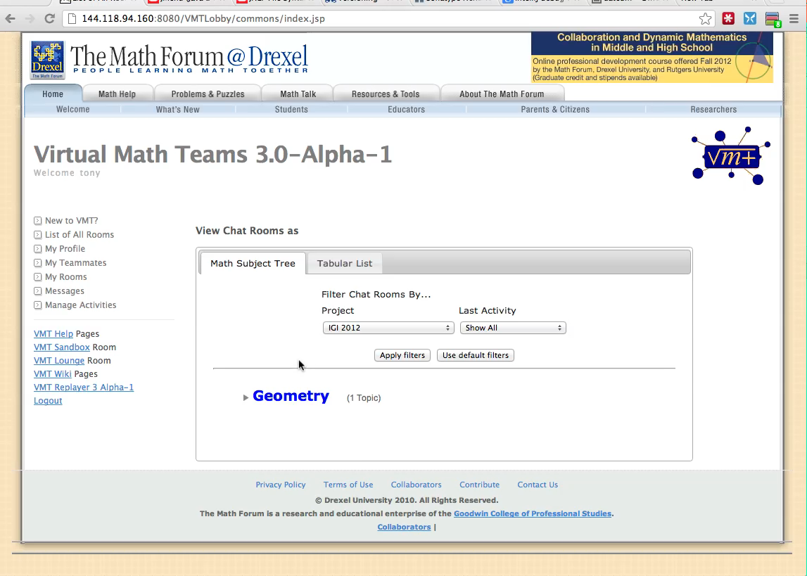
Create your own topic rooms
Notes:
Show movie

Slide 23
6. Supporting collaboration
Virtual math teams are guided by carefully designed and tested curricular resources
They drag points to discover, discuss and reflect on dependencies in figures
They discuss how to construct figures with the needed dependencies and take turns constructing and testing the figures
Notes:
I will now move from the technology to the collaboration itself

Slide 24
Teachers collaborate on inscribed triangles
Notes:
A group of teachers during a professional development course explore a pair of inscribed equilateral triangles.
They discover its dependencies and then construct their own, designing in the same dependencies.

Slide 25
Notes:
emilyL notes how the key dependency was designed into the construction.
As a group they can accomplish something none of them could on their own.

Slide 26
Students collaborate on inscribed squares
Notes:
Now Emily’s students do a similar construction with inscribed squares.
They learned how to design in the dependencies for inscribed triangles
And now generalize the design method for squares

Slide 27
7. Researching the learning processes
Students are asked to identify chat log segments that show effective collaboration and to reflect on what they noticed and wondered about
Teachers are asked to select and reflect on student chat log segments – and to discuss how to improve the resources, approach and experience
Researchers analyze logs and replayer to understand strengths and weaknesses of resources and to investigate how student teams collaboratively master dynamic geometry practices, skills and understanding
Notes:
Students discuss their geometry design work
Their teachers reflect on the student discourse and collaboration
Researchers analyze the interaction to re-design the environment

Slide 28
8. Theorizing the approach & resources
The ideology of individualism views geometry as a realm of mental ideas that individuals must master using logic.
But geometry is a product of the community of mathematicians, math educators and math students during the past 2,600 years; it can be learned collaboratively by teams discovering and creating under the guidance of teachers/educators
There is validity both to the importance of individual mental effort and socio-cultural practices. There should be support at individual, group and community levels
Notes:
The analysis of teachers and students actually collaborating in the VMT system has implications for the theory
We can support individual learners – as collaborators in groups – within larger courses.

Slide 29
Small-Group
Interactional resources
Group Outcomes
Group
Knowledge
Artifacts
Interaction
Context
Sequential
Small-Group
Interaction
Technology & Media
Community
Individual
Voices
Culture of
Discourse
Community
Individuals’
Resources &
Experiences
Individual
Levels of analysis connected by interactional resources
Notes:
The learning on all levels takes place largely through the small-group interaction
This is guided and supported by a variety of carefully designed “resources”

Slide 30
My recent theoretical work
Group cognition as focus of analysis on the inter-personal inter-action
Theory of resources mediating learning
Unity of levels of analysis/interaction:
Individual, team, community (class, schooling, math)
Theory implications of analyses of collaborative dynamic geometry learning
Notes:
I have moved from a focus on “group cognition”
To the connections between the individuals, the group and larger communities
Mediated by a broad spectrum of “resources”

Slide 31
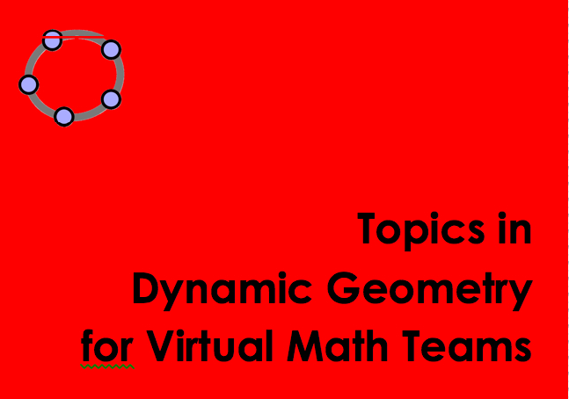
10. Developing the curricular resources
Although the VMT Project was funded to just develop the technology and analyze its effectiveness, the real problem is to design the pedagogy: approach & resources
We developed a set of about 18 “topics” in a workbook format that included tutorial “tours” of the technology. Each topic was intended for about a one-hour online, synchronous, collaborative session. Each topic included 3 to 10 GeoGebra tabs with guiding tasks
Notes:
We have about 100 GeoGebra tasks or resources designed to guide and support collaborative learning

Slide 32
Pedagogical focus
The approach emphasis includes:
The importance of experiencing first-hand the actual doing of mathematics: exploration, noticing, discovering, wondering, conjecturing, creating, designing, constructing, explaining, understanding, proving, teaching
Resisting the tradition of accepting on authority the definitions and understandings of geometric objects
Resisting the temptation to use GeoGebra just to illustrate geometric facts with pretty figures or flashy simulations
Guiding teachers and students to design their own constructions, including the definition of custom tools
Emphasizing the role of dependencies in dynamic geometry
Notes:
Our approach tries to realize the potential of dynamic geometry
It contrasts in several ways with how dynamic geometry is usually taught
Of course, ours is the first collaborative versions of dynamic geometry

Slide 33
Beginning topics
Warm up – login and create points
Messing with dynamic geometry – dragging points; copying & adding segment lengths
Visualizing Thales’ and Pythagoras’ theorems
Constructing equilateral triangles
Programming custom tools: perpendicular lines, parallel lines, equilateral triangles
Finding 8 centers of triangles – challenge: Euler’s segment and the nine-point circle of a triangle
Notes:
Our pedagogy starts by translating some standard beginning geometry topics

Slide 34
Notes:
Here, we visualize dependencies of segment lengths, while training in techniques for designing dependent constructions

Slide 35
Intermediate topics
7. Rigid transformations, symmetry, proof of area of a triangle
8. Exploring angles of triangles and similar triangles
9. Visualizing congruent triangles
10. Solving typical geometry problems
11. Constructing inscribed triangles & polygons
12. Building a hierarchy of kinds of triangles
Notes:
The students experience topics involving thinking about geometric relationships

Slide 36
Notes:
Above, students are given more complicated constructions
And they are able to create their own custom tools, to package construction sequences

Slide 37
Advanced topics
13. Constructing a square and other quadrilaterals
14. Building the hierarchy of quadrilaterals
15. Constructing a tangent geometrically and using the GeoGebra algebra interface
16. Proving incenter properties and Euler segment properties with constructed dependencies
17. Modeling a factory workflow with systems of rigid transformations
18. Exploring taxicab transformational geometry
Notes:
Finally, advanced students and math teachers are given open-ended mini-worlds of math to explore creatively

Slide 38
Notes:
They become skilled at identifying built-in dependencies and designing how to construct them themselves
They also explore rigid transformations, discovering for themselves relationships among the different transformations

Slide 39
11. Design-based research of human-centered geometry
Discover: The curricular topics guide student teams and teacher teams to discover dependencies in dynamic-geometric figures
Create: The curricular topics guide student teams and teacher teams to creatively design and construct dependencies in dynamic-geometric figures
Understand, explain, prove: Students and teachers learn to view geometric truths in terms of constructed dependencies. They begin to see the causality of the world as human/social creative-discovery involving designed dependencies
The VMT Project evolves its pedagogical approach through iterative analysis of interactions among teams of researchers or teachers or students using the technology and resources. The research process is reflected in its publications and presentations.
Notes:
The philosophy of our collaborative dynamic geometry is a students-centered one of “creative-discovery”
The truth is not just out there based on authorities, but is created by the learner through a dialectic of creation and discovery.
The VMT Project is itself a design project, which integrates experimental discovery with creative pedagogical design

Slide 40
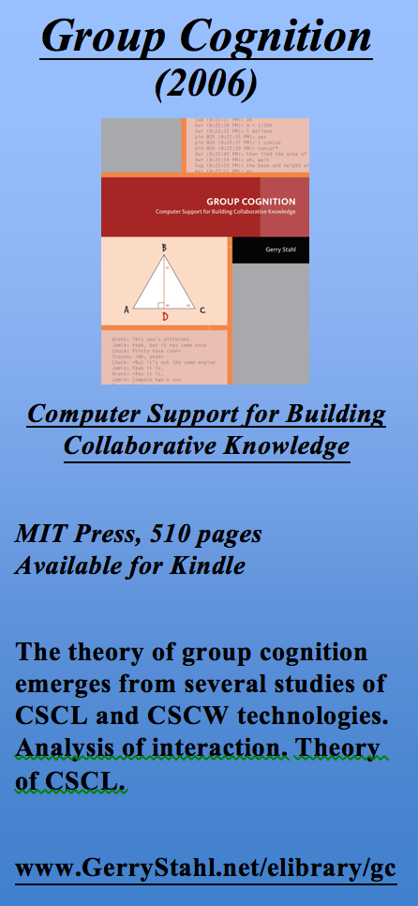
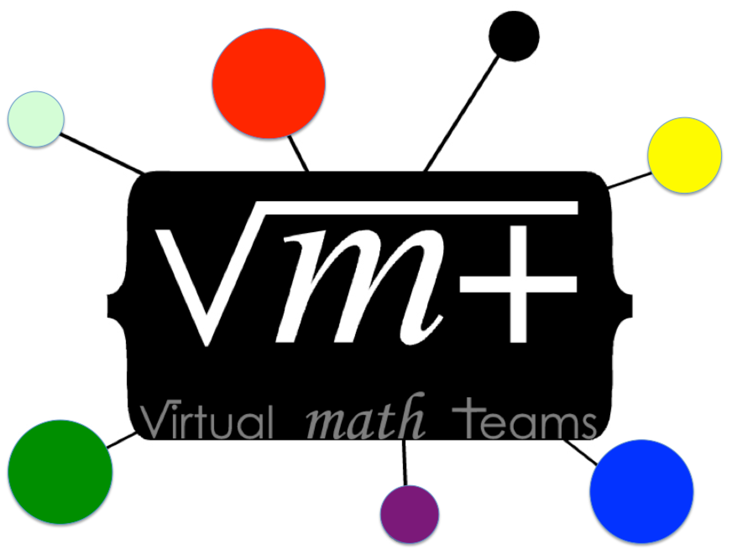
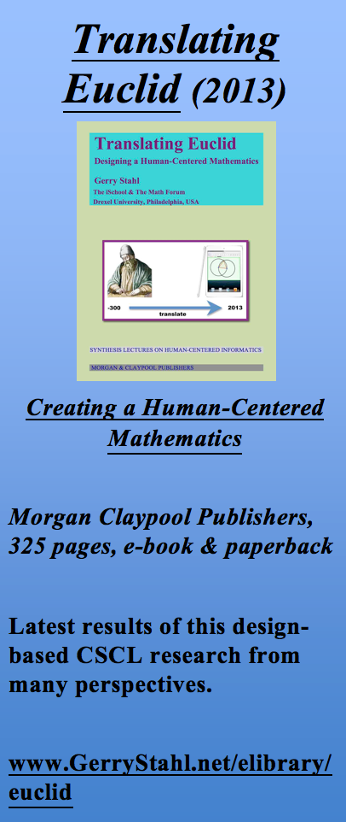
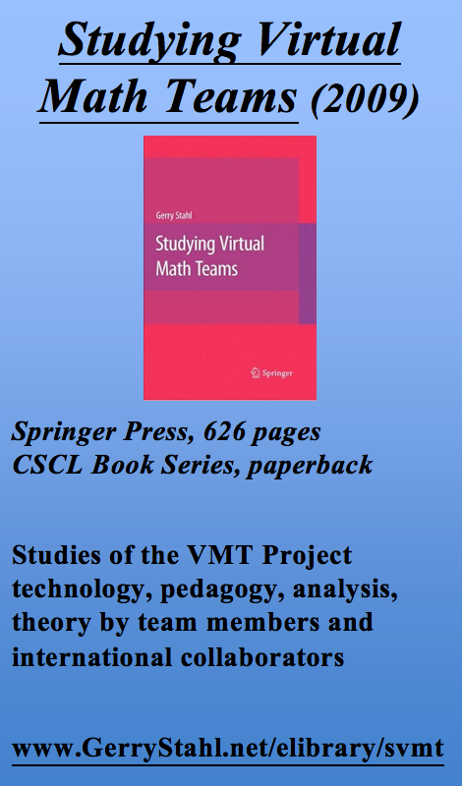
The Virtual Math Teams Trilogy
Notes:
The VMT Project is now documented in a trilogy of books from 2006, 2009 and 2013.

Slide 41
For further info…
Email:
  Gerry@GerryStahl.net
Website:
www.GerryStahl.net
Topics in Dynamic Geometry for VMT:
www.GerryStahl.net/elibrary/topics
Translating Euclid:
  www.GerryStahl.net/elibrary/euclid
Studying Virtual Math Teams:
www.GerryStahl.net/elibrary/svmt
Group Cognition:
  www.GerryStahl.net/elibrary/gc
Slides:
        www.GerryStahl.net/pub/didactics.pdf www.GerryStahl.net/pub/designing.pdf www.GerryStahl.net/pub/analyzing.pdf
Notes:
You can find more information on the project at my website
These slides are also available

